Slide 1

CIS 133DA Final Proposal
Adriana Avila

Slide 2
Natalia’s Sweet Bakery
Home
Treats
Custom Orders
About Me
Order Form

Slide 3

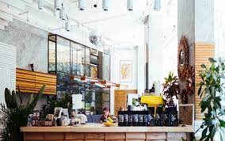
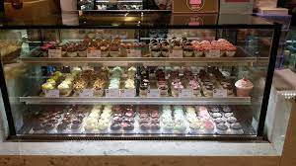
Natalia’s Sweet Bakery
Treats
Custom Orders
About Me
Whether you’re in search of a quick treat or a slow morning, stop by Natalia’s. We’d love to host you!

Slide 4
Natalia’s Sweet Bakery
Treats
Custom Orders
About Me
Treats
Treat | Flavor | Quantity
Cupcakes | Peanut Butter, Chocolate, Birthday Cake, Strawberry | single 4-pack 6-pack baker’s dozen*
Pies | Chocolate Cream, Lemon Meringue, Fruit Pie (rotating flavor) | by the slice whole pie*
Drinks | Coffee Hot Chocolate Hot Tea Bottled Water Fruit

Slide 5
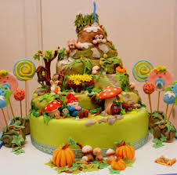
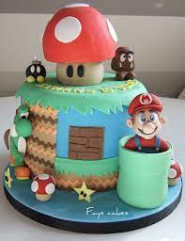
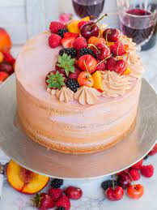
Natalia’s Sweet Bakery
Treats
Custom Orders
About Me
Custom Orders
Custom cakes are a fun addition to any celebration. They are made uniquely for every individual.
Orders must be submitted 6 weeks in advance.
Treat your loved one today!

Slide 6
Natalia’s Sweet Bakery
Treats
Custom Orders
About Me
Order Form
First Name
Last Name
Email Address
Phone Number
Custom Character Money Cake
Details

Slide 7
Natalia’s Sweet Bakery
Treats
Custom Orders
About Me
About Me
Hello my name is Natalia.
I have a degree in engineering, but my passion has always been baking. Ever since I was young, I loved to bake and cook with my family. In my younger days I maintained a blog that where I enjoyed sharing recipes with others. You might ask how an engineer came to own and run a bakery? Well, when I came to realize that baking was more than a hobby it was not a difficult choice for me to change courses pursue my passion.
It is a true honor to share my love and creations with others. I hope that Natalia’s become a second home to you. Thank you for your unyielding support.

